Slide 1

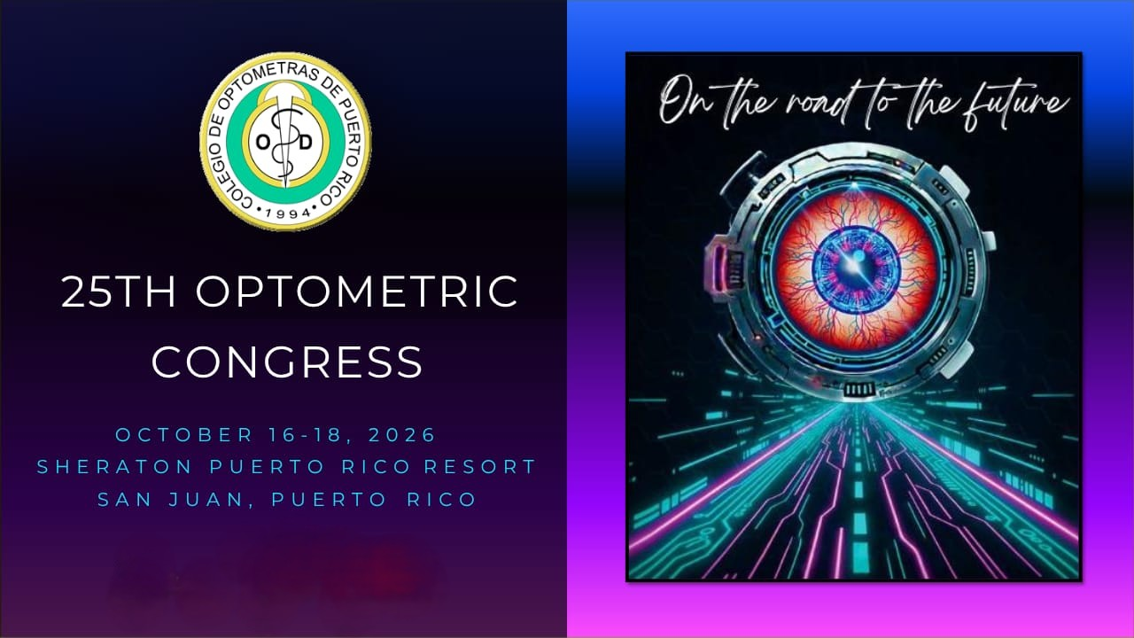

Message from the President’s Commission
Dear Colleagues:
On behalf of the 2026 Congress Committee, it is my great pleasure to invite you to attend the 2026 Puerto Rico Optometric Congress, "On the Road to the Future," taking place October 16-18, 2026, at the Sheraton Puerto Rico Hotel & Convention Center, located in the vibrant Distrito T-Mobile in San Juan, Puerto Rico.
This year's congress has been designed to provide a comprehensive weekend of continuing education, professional development, and networking opportunities for optometrists from across Puerto Rico and beyond. Attendees will enjoy a full three-day program featuring distinguished speakers, the latest clinical advances, emerging technologies, and discussions focused on the future of optometric care.
As our profession continues to evolve, it is more important than ever to stay informed about innovations in patient care, ocular disease management, diagnostic technology, and the growing role of artificial intelligence in healthcare.
Our goal is to equip attendees with the knowledge and tools needed to navigate the future of optometry with confidence and excellence.
We look forward to welcoming you to what promises to be an engaging, educational, and inspiring event. Join us as we come together to learn, connect, and shape the future of our profession.
Thank you for your continued commitment to advancing optometric care in Puerto Rico.
¡We hope to see you in October 2026!
Sincerely,
Dr. Anouk Underwood
President 2026 Congress Committee

Slide 2

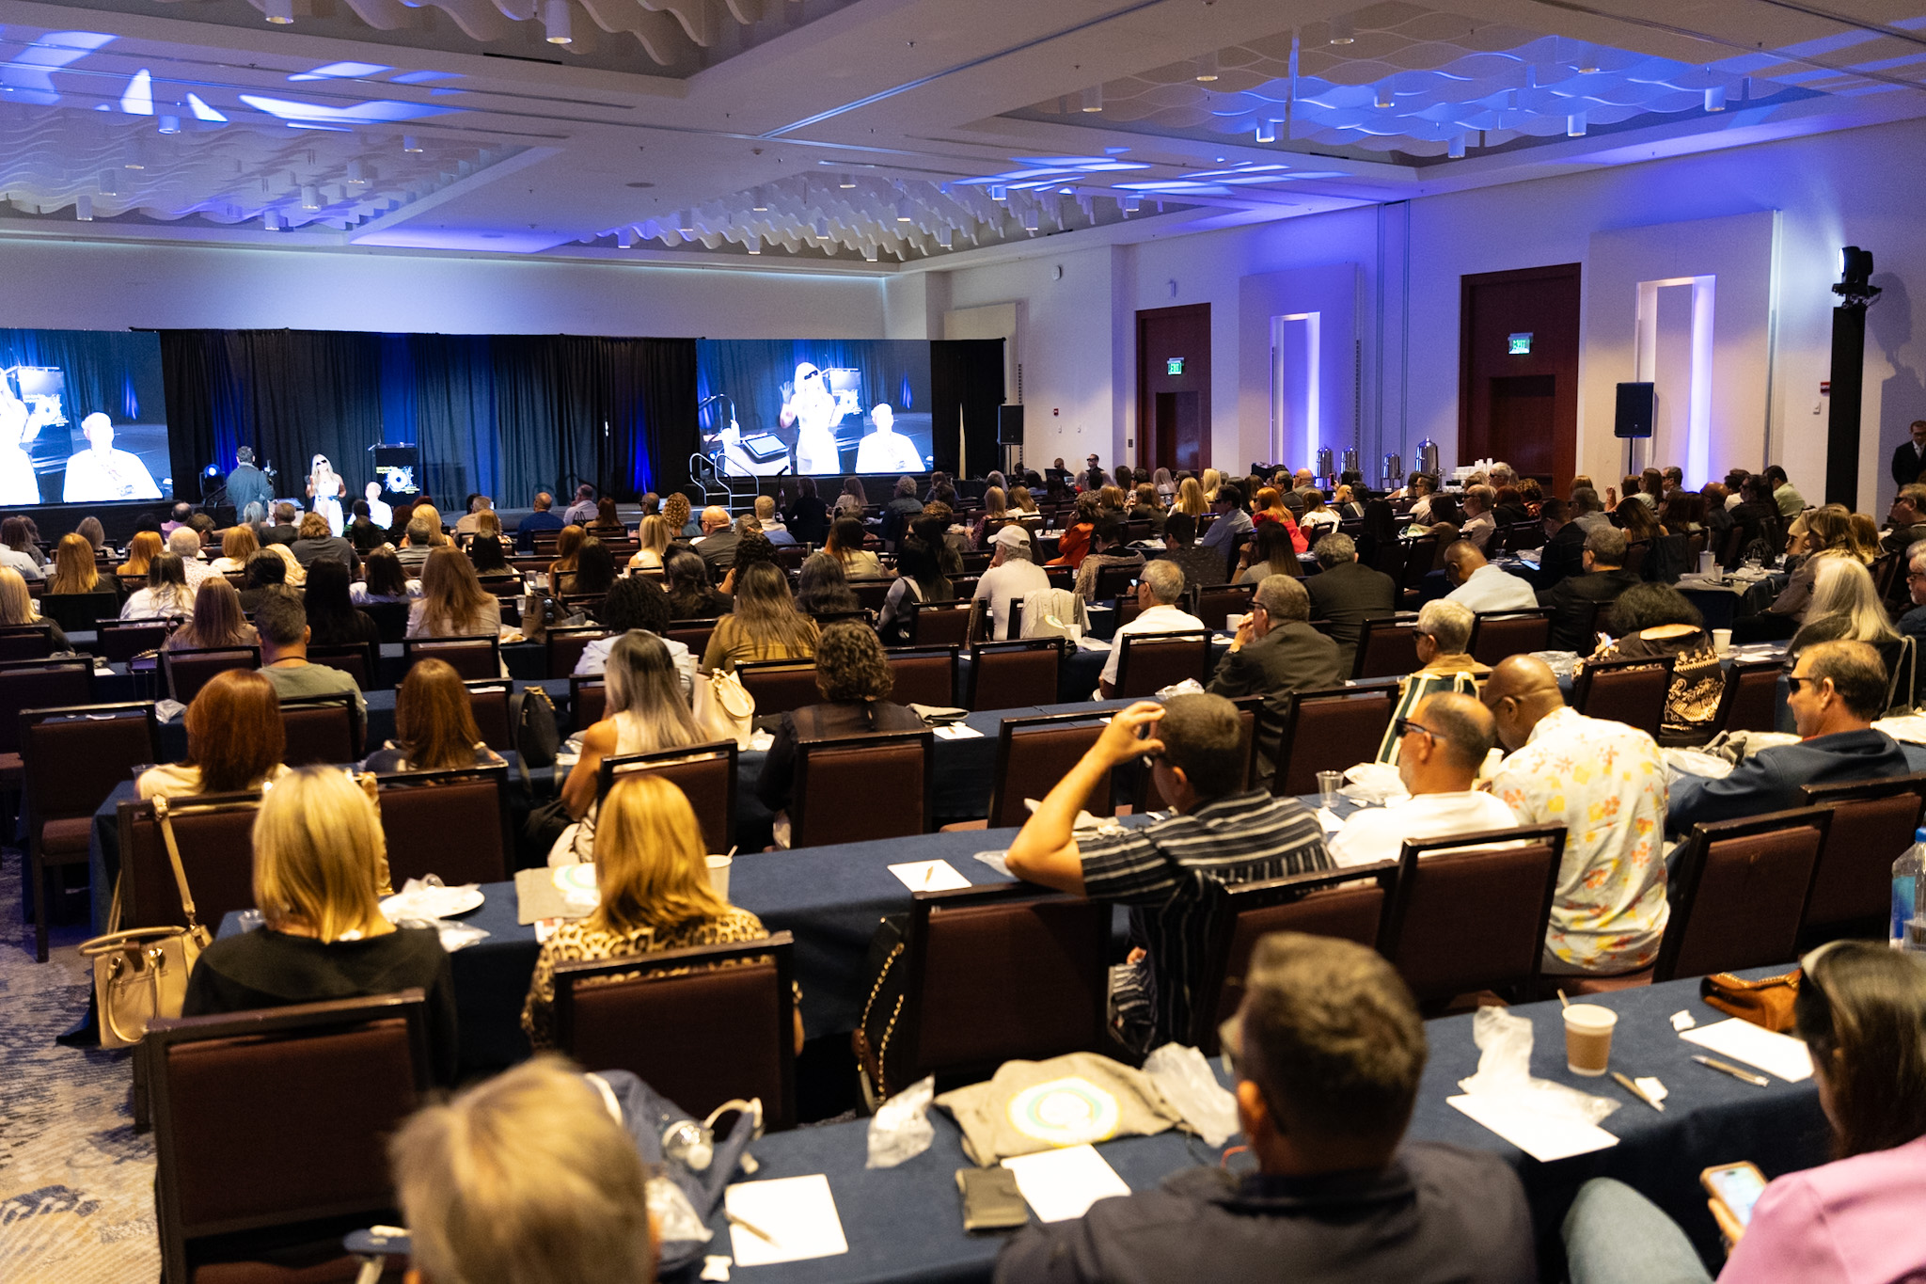
Preliminary program *Subject to change*
Friday, October 16
8:00 am – 9:30 am OD Registration, Exhibitors & Breakfast
San Juan Ballroom
9:45 am – 10:00 am Welcome
Dr. Walter Ramírez and Dr. José M. De Jesus
Miramar Ballroom
10:00 am – 11:30 am neuro-ophthalmic perspectives on glp-1 receptor agonist,
assessing the risk of naion
Dr. Miguel Santiago (1.5 credit hours)
Miramar ballroom
10:30 am Coffee Station
San Juan Ballroom/Miramar Ballroom
11:00 am – 12:00 pm Exhibitors Lunch
San Juan Ballroom
11:30 am – 12:00 pm Tribute Dr. Luis Ortiz Whatts
Miramar Ballroom
12:00 pm – 3:00 pm Lunch and exhibitions
San Juan Ballroom
3:00 pm – 4:00 pm Visual Complications in Patients suffering from sleep apnea
Dr. Ruth santos (1 credit hour)
Miramar Ballroom
4:00 pm- 4:30 PM Coffee Break
Miramar & San Juan Ballroom
4:30 pm – 5:30 pm The Eye as a Window to Systemic Disease: Fundus and OCT Clues You Can’t Miss
Dr. Karla Alejandro (1 credit hour)
Miramar Ballroom
5:30 pm – 6:30 pm Diabetic Retinopathy Uncovered: Early Clues, Modern Treatments, Better Outcomes Dr. Karla Alejandro (1 credit hour) Miramar Ballroom
6:30 pm - 8:30 pm Exhibits/Stand Up Comedy & Cocktail San Juan Ballroom

Slide 3
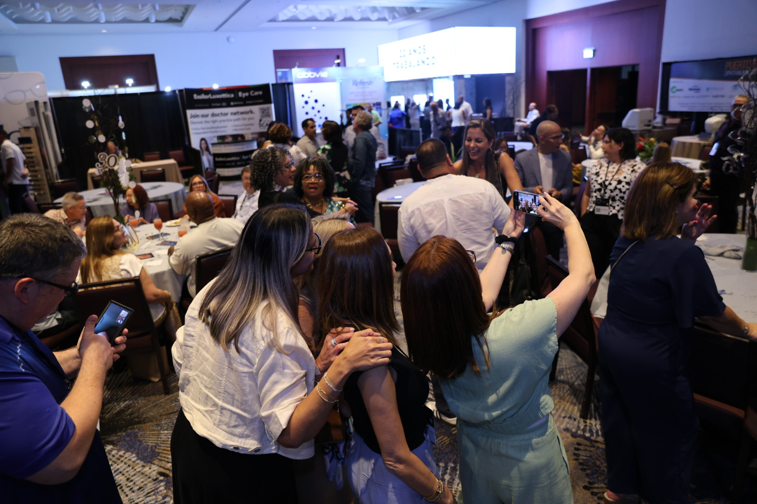
Preliminary program *Subject to change*
sATURDAY, October 17
7:00 am – 8:00 am Pilates classes
Dra. Diana Shechtman
Laguna room 1, 2
8:00 am – 9:00 am Registration, Breakfast & Exhibits San Juan Ballroom
9:00 am – 11:00 am “From Fear to Focus: Incorporating AI into Eyecare” (102812-PM) Kyle Shechtman and Dr. Michael Venincasa Miramar Ballroom
10:30 am- Coffee Station San Juan and Miramar Ballroom
11:00 am – 12:00 pm Retinal Grand Rounds I (101789-TD)
Dr. Diana Shechtman and Dr. Michael Venincasa Miramar Ballroom
Exhibitor’s Lunch
San Juan Ballroom
12:00 pm – 3:00 pm Lunch and exhibitions San Juan Ballroom
1:00 pm – 4:00 pm Lunch and conference office staff
Laguna Room 1-2
3:00 pm - 4:00 pm Retinal Grand Rounds II (101791-TD)
Dr. Diana Shechtman and Dr. Michael Venincasa
Miramar Ballroom
4:00 pm- 4:30 pm Coffee Break & Exhibits
San Juan Ballroom
4:30 pm – 6:30 pm Under Pressure: How to Drop it Down Low (101792-GL)
Dr. Diana Shechtman
Miramar Ballroom
6:30 pm- 8:30 pm Exhibits/Debora brum Music & Cocktail
San Juan Ballroom

Slide 4
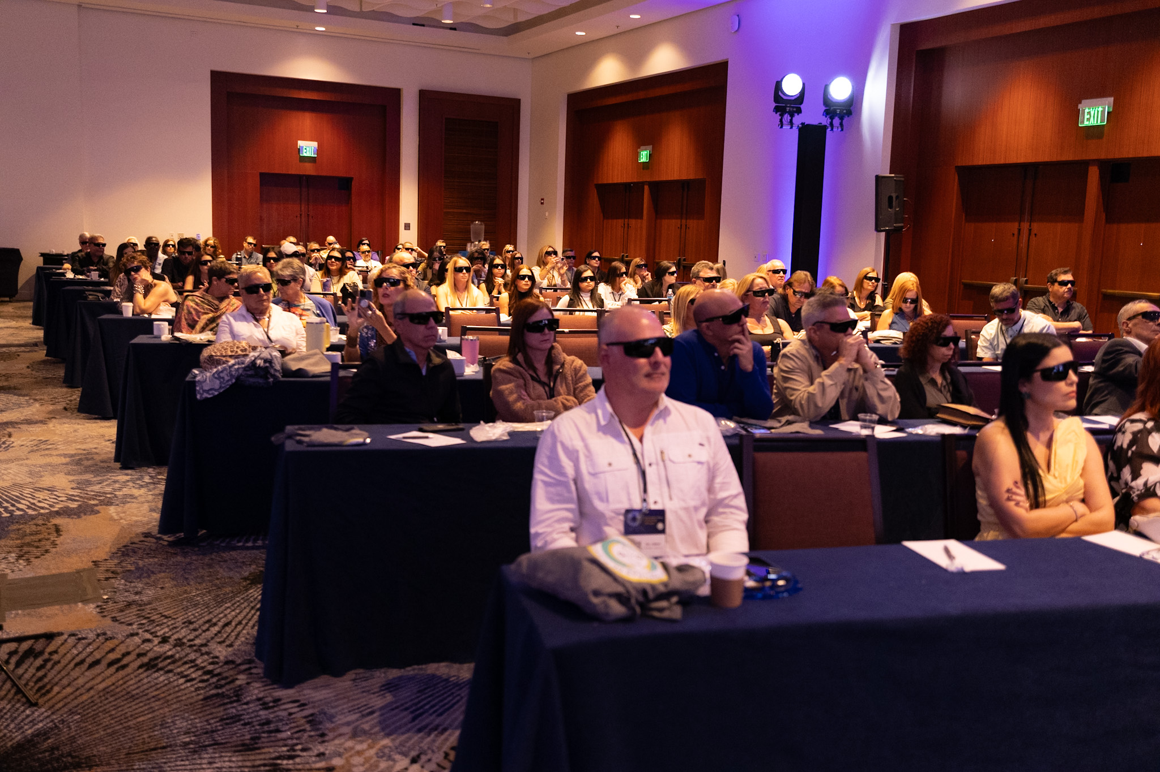
Preliminary program
SUNDAY, OCTOBER 18
8:00 am – 9:00 am Registration, Breakfast & Exhibits San Juan Ballroom
9:00 am – 12:00 pm Medidas de Control de Infecciones, Tuberculosis, VIH y Hepatitis
Puntos Ciegos: Lo que olvidamos sobre salud sexual y bioseguridad en la consulta
Dr. José Beltran (3 credit hours)
Miramar Ballroom
12:00 pm Closing

Slide 5
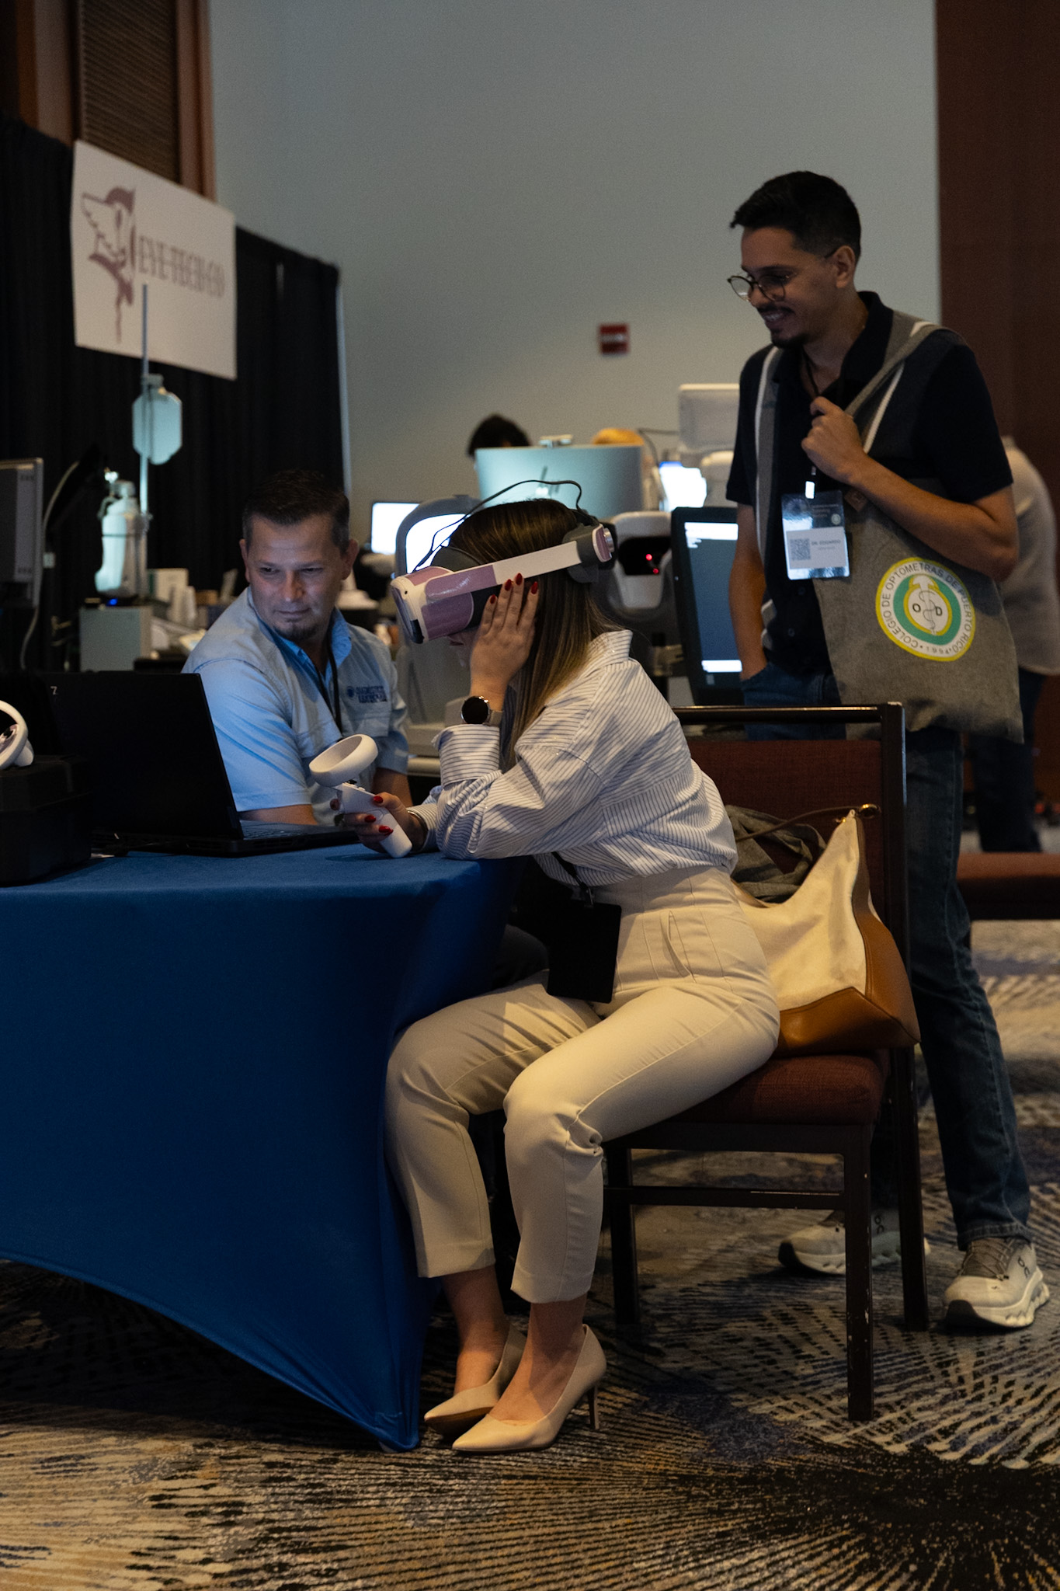
General information
1. Congress reservations can be made by filling out the registration form and sending it by email to: info@colegiooptometraspr.com or by mail : P.O. Box 363551 San Juan, P.R. 00936-3551.
2. As this activity is exclusive to the Colegio de Optometras for its members and participants, no one who has not registered will be allowed in the conference or exhibits areas.
3. Registrations and payments are non-transferable, regardless of the person.
4. In case of cancellation, no refunds will be made, nor will credit be granted to any other activity.
5. Children will not be accepted, under any circumstances , in the conference or exhibit halls. Please make arrangements in advance.
6. The courses will be submitted for approval by the Puerto Rico Board of Optometrists and COPE.

Slide 6
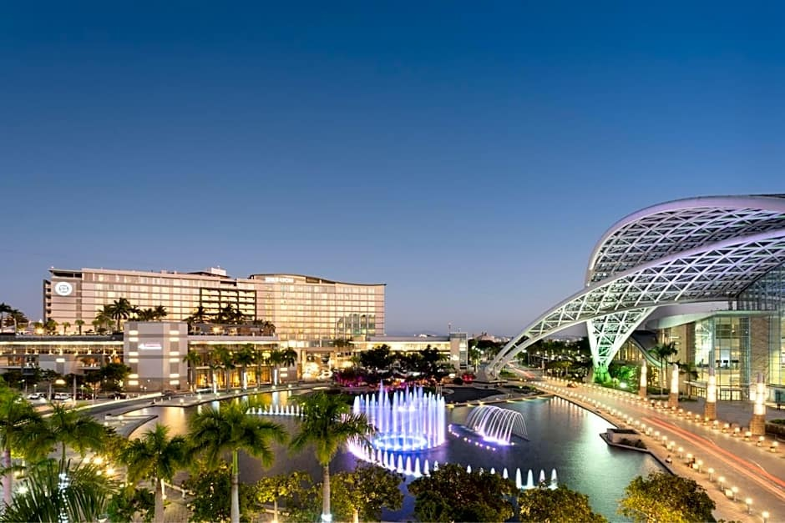
Rooms reservation
Attendees can make their own reservations directly with our reservation office at phone number:
1-866-932-7269 / 787-993-3500
Sheraton Puerto Rico Resort, San Juan
$294.00 per night, plus taxes
Group Code: OPT
Booking link: Reserve tu tarifa de grupo para el Congreso de Optometría Oct2026

